Slide 1
Chapter 5: CPU Scheduling

Slide 2
Chapter 5: CPU Scheduling
Basic Concepts
Scheduling Criteria
Scheduling Algorithms
Examples

Slide 3
Objectives
To introduce CPU scheduling, which is the basis for multiprogrammed operating systems
To describe various CPU-scheduling algorithms
To discuss evaluation criteria for selecting a CPU-scheduling algorithm for a particular system

Slide 4
Basic Concepts
Maximum CPU utilization obtained with multiprogramming
Continuous Cycle :
one process has to wait (I/O)
Operating system takes the CPU away
Give CPU to another process
This pattern continues
CPU–I/O Burst Cycle – Process execution consists of a cycle of CPU execution and I/O wait

Slide 5
CPU and I/O Burst Cycle
Almost all processes alternate between two states in a continuing cycle, as shown in Figure below :
A CPU burst of performing calculations, and
An I/O burst, waiting for data transfer in or out of the system.
Processes alternate back and forth between this two states.

Slide 6
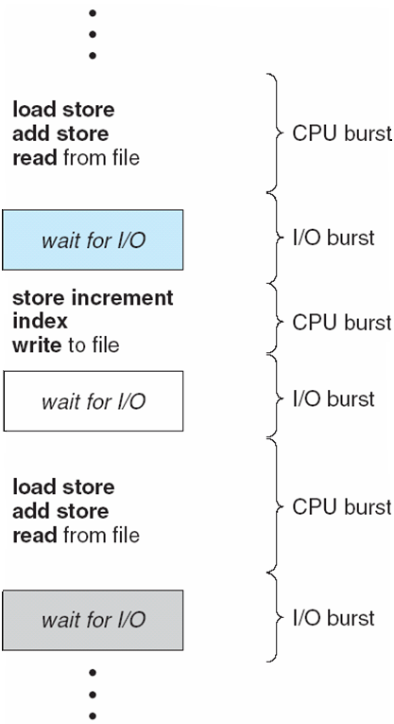
Alternating Sequence of CPU and I/O Bursts

Slide 7
CPU Scheduler
Selects from among the processes in ready queue, and allocates the CPU to one of them
FIFO queue
Priority queue
Tree
Unordered linked-list
CPU scheduling decisions may take place when a process:
1. Switches from running to waiting state (I/O request)
2. Switches from running to ready state (e.g. when interrupt occurs)
3. Switches from waiting to ready (e.g. at completion of I/O)
Terminates
Scheduling under 1 and 4 is nonpreemptive
All other scheduling is preemptive
Consider access to shared data
Consider preemption while in kernel mode
Consider interrupts occurring during crucial OS activities

Slide 8
Scheduling Criteria
CPU utilization – keep the CPU as busy as possible
Throughput – # of processes that complete their execution per time unit
Turnaround time – amount of time to execute a particular process -- the interval from the time of submission of a process to the time of the completion. -- sum of the periods spent waiting to get into memory, wainting in the ready queue, executing on the CPU, doing I/O
Waiting time – amount of time a process has been waiting in the ready queue
Response time – amount of time it takes from when a request was submitted until the first response is produced, not output (for time-sharing environment)

Slide 9
Scheduling Algorithm Optimization Criteria
Max CPU utilization
Max throughput
Min turnaround time
Min waiting time
Min response time

Slide 10
First-Come, First-Served (FCFS) Scheduling
Process Burst Time
P₁ 24
P₂ 3
P₃ 3
Suppose that the processes arrive in the order: P₁ , P₂ , P₃ The Gantt Chart for the schedule is:
P₁
P₂
P₃
0
24
27
30
Waiting time for P₁ = 0; P₂ = 24; P₃ = 27
Average waiting time: (0 + 24 + 27)/3 = 17
Turnaround time P₁ = 24; P₂ = 27; P₃ = 30

Slide 11
FCFS Scheduling (Cont.)
Suppose that the processes arrive in the order:
P₂ , P₃ , P₁
The Gantt chart for the schedule is:
P₂
P₃
P₁
0
3
6
30
Waiting time for P₁ = 6; P₂ = 0; P₃ = 3
Average waiting time: (6 + 0 + 3)/3 = 3
Much better than previous case
Convoy effect - short process behind long process
Consider one CPU-bound and many I/O-bound processes

Slide 12
FCFS Scheduling (Cont.)
Convoy Effect :
many I/O bound process and one CPU bound process
CPU bound process | I/O bound process | Effect
I/O device | I/O queue | CPU site idle
CPU processing | Ready queue | I/O site idle

Slide 13
Shortest-Job-First (SJF) Scheduling
Associate with each process the length of its next CPU burst. Use these lengths to schedule the process with the shortest time
Two schemes:
Non-preemptive – once CPU given to the process it cannot be preempted until completes its CPU burst
preemptive – if a new process arrives with CPU burst length less than remaining time of current executing process, preempt. This scheme is know as the Shortest-Remaining-Time-First (SRTF)
SJF is optimal – gives minimum average waiting time for a given set of processes

Slide 14
Example of SJF
ProcessArriva l Time Burst Time
P₁ 0.0 6
P₂ 2.0 8
P₃ 4.0 7
P₄ 5.0 3
SJF scheduling chart
P₄
P₁
P₃
P₂
0
3
9
16
24
Average waiting time = (3 + 16 + 9 + 0) / 4 = 7

Slide 15
Example of Non-Preemptive SJF
Process Arrival Time Burst Time
P₁ 0.0 7
P₂ 2.0 4
P₃ 4.0 1
P₄ 5.0 4
SJF (non-preemptive)
P₁
P₃
P₂
P₄
0
3
7
8
12
16
Average waiting time = (0 + 6 + 3 + 7)/4 = 4

Slide 16
Example of Preemptive SJF
Process Arrival Time Burst Time
P₁ 0.0 7
P₂ 2.0 4
P₃ 4.0 1
P₄ 5.0 4
SJF (preemptive)
Average waiting time = (9 + 1 + 0 +2)/4 = 3
P₁
P₂
P₃
P₂
P₄
P₁
0
2
4
5
7
11
16

Slide 17
Example of Shortest-remaining-time-first
Now we add the concepts of varying arrival times and preemption to the analysis
ProcessA arri Arrival TimeT Burst Time
P₁ 0 8
P₂ 1 4
P₃ 2 9
P₄ 3 5
Preemptive SJF Gantt Chart
Average waiting time = [(10-1)+(1-1)+(17-2)+5-3)]/4 = 26/4 = 6.5 msec
P₁
P₂
P₄
P₁
P₃
0
1
5
10
17
26

Slide 18
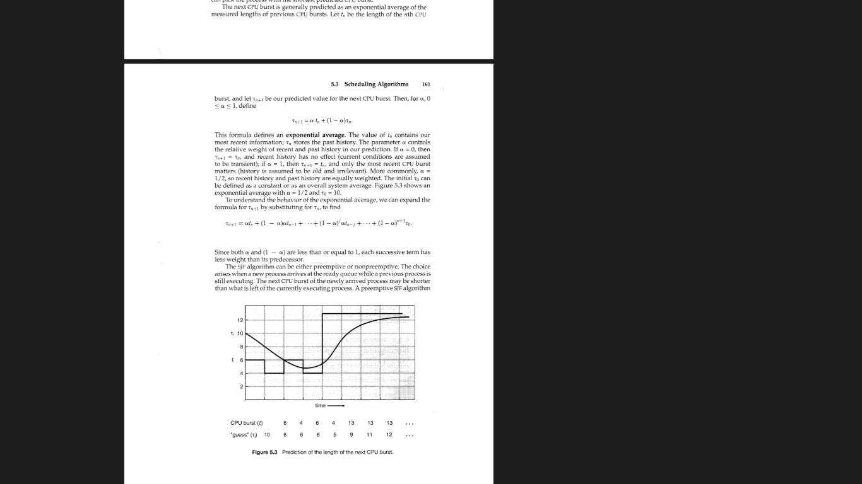
Exponential average
Page – 221/946

Slide 19
Priority Scheduling
A priority number (integer) is associated with each process
The CPU is allocated to the process with the highest priority (smallest integer ≡ highest priority)
Preemptive
Nonpreemptive
SJF is priority scheduling where priority is the inverse of predicted next CPU burst time
Priority can be defined either internally or externally.
Factors for internal priority assignment:
Time limit, memory requirements, the number or open files etc.
Factors for external priority assignment:
Importance of the process, the type and amount of funds of funds being paid for computer use, department sponsoring works etc.

Slide 20
Example of Priority Scheduling
ProcessA arri Burst TimeT Priority
P₁ 10 3
P₂ 1 1
P₃ 2 4
P₄ 1 5
P₅ 5 2
Priority scheduling Gantt Chart
P₂
P₅
P₁
P₃
P₄
0
1
6
16
18
19
Average waiting time = 8.2 msec

Slide 21
Priority Scheduling
Problem ≡ Starvation – low priority processes may never execute
Solution ≡ Aging – as time progresses increase the priority of the process

Slide 22
Round Robin (RR)
Each process gets a small unit of CPU time (time quantum q), usually 10-100 milliseconds. After this time has elapsed, the process is preempted and added to the end of the ready queue.
If there are n processes in the ready queue and the time quantum is q, then each process gets 1/n of the CPU time in chunks of at most q time units at once. No process waits more than (n-1)q time units.
Timer interrupts every quantum to schedule next process
Performance
q large ⇒ FIFO
q small ⇒ q must be large with respect to context switch, otherwise overhead is too high

Slide 23
Example of RR with Time Quantum = 4
Process Burst Time
P₁ 24
P₂ 3
P₃ 3
The Gantt chart is:
P₁
P₂
P₃
P₁
P₁
P₁
P₁
P₁
0
4
7
10
14
18
22
26
30
Average waiting time is 17 / 3 = 5.66 milisecond
Typically, higher average turnaround than SJF, but better response
quantum should be large compared to context switch time
Quantum usually 10ms to 100ms, context switch < 10 usec

Slide 24
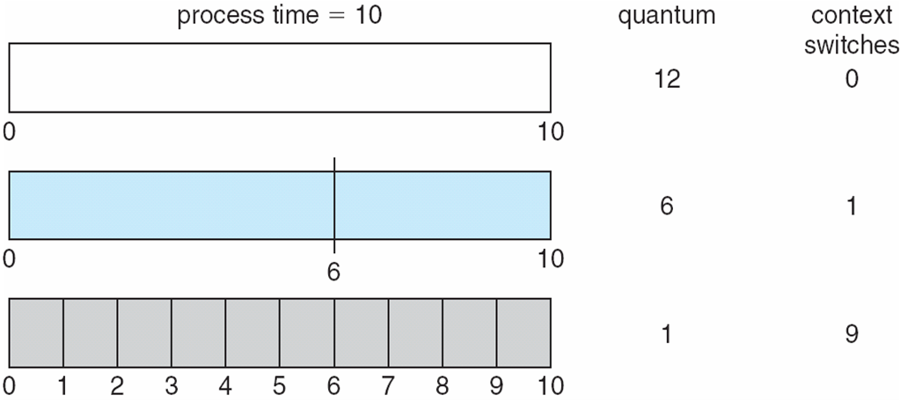
Time Quantum and Context Switch Time

Slide 25
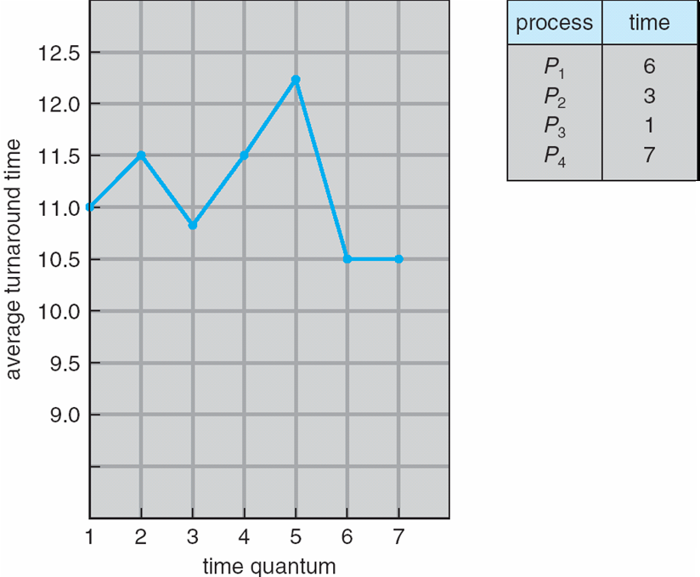
Turnaround Time Varies With The Time Quantum
80% of CPU bursts should be shorter than quantum

Slide 26
Multilevel Queue
Another class of scheduling algorithm needs- in which processes are classified into different groups, e.g.:
foreground (interactive) processes
background (batch) processes
They have different response time requirements-so different scheduling needs.
Foreground processes may have priority over background processes.
A multilevel queue-scheduling algorithm partitions the ready queue into several separate queues-we can see it in the figure of next slide:-
Each queue has its own scheduling algorithm:
Foreground queue scheduled by – RR algorithm
Background queue scheduled by – FCFS algorithm
Scheduling must be done between the queues:
Fixed priority preemptive scheduling; (i.e., serve all from foreground then from background). Possibility of starvation.
Time slice – each queue gets a certain amount of CPU time which it can schedule amongst its processes; i.e., foreground queue can be given 80% of the CPU time for RR-scheduling among its processes, while 20% to background in FCFS manner.

Slide 27
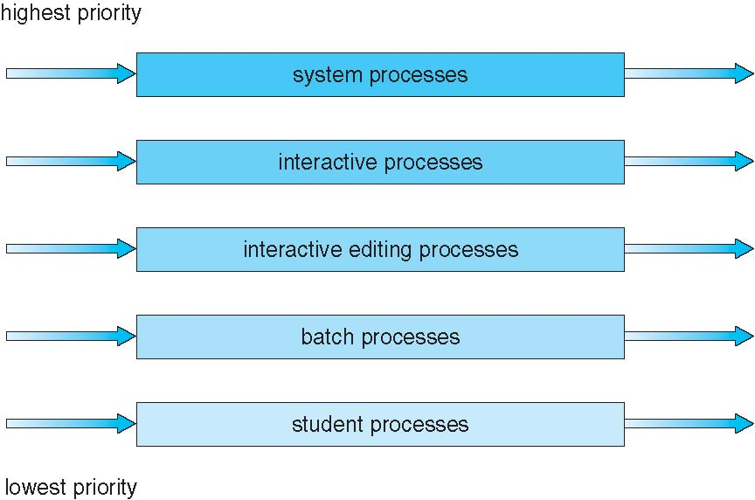
Multilevel Queue Scheduling
Notes:
Partitions ready queue into several queues.

Slide 28
Multilevel Feedback Queue scheduling
Processes do not move from one queue to the other----But
Multilevel Feedback Queue scheduling, allows a process to move between queues.
If a process uses too much CPU time, it will be moved to a lower priority queue.
Similarly, a process that waits too long in a lower-priority queue may me moved to a higher-priority queue.

Slide 29
Multilevel Feedback Queue scheduling
Multilevel-feedback-queue scheduler defined by the following parameters:
number of queues
scheduling algorithms for each queue
method used to determine when to upgrade a process
method used to determine when to demote a process
method used to determine which queue a process will enter when that process needs service

Slide 30
Example of Multilevel Feedback Queue
Three queues: (can see the figure in next slide)
Q₀ – RR with time quantum 8 milliseconds
Q₁ – RR time quantum 16 milliseconds
Q₂ – FCFS
Scheduling
A new job enters queue Q₀ which is served for RR
When it gains CPU, job receives 8 milliseconds
If it does not finish in 8 milliseconds, job is moved to queue Q₁
At Q₁ job is again served RR and receives 16 additional milliseconds
If it still does not complete, it is preempted and moved to queue Q₂

Slide 31
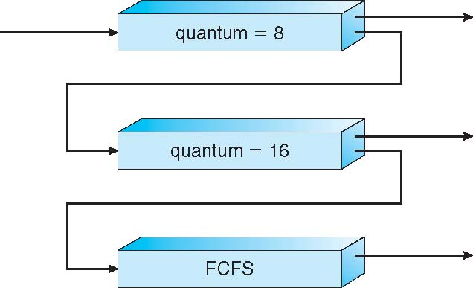
Multilevel Feedback Queues

Slide 32
End of Chapter 5

